Slide 1
Team 10
Javed Nissar
Joey Zhou
Vincent Chou

Slide 2
Table of Contents
High-level explanations of solutions (HLES)
Optimizations

Slide 3
HLES (Part 1-A,B)
Knowing that 1-A is a special case of 1-B, 1-C, we can base the algorithm of A heavily on one of the latter.
Ours uses 1-B as a model -- for the case the key k is only one value, shift all characters in ASCII by k steps.
On char c = ‘Z’, loop back to the start by calculating ASCII values.
Ignore non-alphanumeric characters (including spaces)
This operation is O(n) for both encrypt & decrypt.

Slide 4
HLES (Part 1-C)
Part c uses alphabet indices instead
New alphabet permutation has the same amount of characters as old alphabet permutation, so one-to-one mapping of indices
Once again, ignore non-alphanumeric characters (including spaces)
O(n)
ABCDEFGHIJKLMNOPQRSTUVWXYZ
0 1 2 3 4 5 6 7 8 9 10 11 12 13 14 15 16 17 18 19 20 21 22 23 24 25
QWERTYUIOPASDFGHJKLZXCVBNM

Slide 5
HLES (Part 2a) Pre-processing
Pre-processing more-simplified than Part 1 since we can just ignore spaces now
After following listed guidelines, end up only with capitalized, alphabetical letters, no spaces.
Luckily python has quite a few utility functions with the listed constraints, see code snippet on the next page:

Slide 6
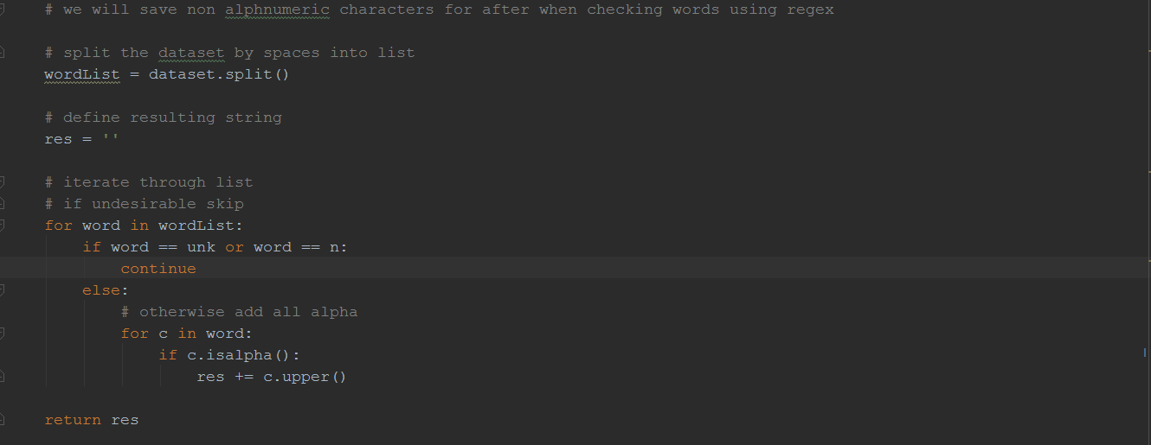
HLES (Part 2a) Pre-processing Part 2

Slide 7
HLES (Part 2a) Count
Important to note that we need results from previous counts
Idea: Keep hashmap of previous counts, adding new entries every time count is called for Θ(1) access
Assumptions: the data set is not changed throughout the process
Count takes in the following parameters: <String> dataset, <String> matchString (or ngram), <Dictionary/Hashmap> dict. If dict is nil, preprocess and count.

Slide 8
Optimizations (Datarunner)
The data runner provides an interface for the input files to be prepared as parameters for our encrypt/decrypt files.

